Slide 2
Current data on aircrew exposure in Belgium

Slide 3
Occupational exposure
Which part of the occupational exposure the aircrew sector is contributing to?
Aircrew is not yet in the national dose registry (NDR) but transferring the doses to the NDR has been enforced in Belgian regulation
Using of rough data

Slide 4
2018
Monitored workers | E < RL | RL ≤ E < 1 mSv | 1 mSv ≤ E < 5 mSv | 5 mSv ≤ E < 10 mSv | 10 mSv ≤ E < 15 mSv | 15 mSv ≤ E < 20 mSv | 20 mSv ≤ E | Total
All fields | 31666 | 16013 | 5155 | 147 | 15 | 5 | 1 | 53002
Medical field | 20195 | 7940 | 628 | 48 | 6 | 2 | 0 | 28819
Industry | 4198 | 3401 | 138 | 14 | 1 | 0 | 0 | 7752
Nuclear field | 2591 | 2290 | 494 | 47 | 3 | 0 | 0 | 5425
Transport | 298 | 302 | 35 | 12 | 1 | 0 | 0 | 648
Research and education | 3921 | 715 | 104 | 6 | 2 | 0 | 0 | 4748
Natural sources | 0¹ | 1089 | 3701 | 4 | 0 | 0 | 0 | 4794
Other fields | 463 | 276 | 55 | 16 | 2 | 3 | 1 | 816
E = annual effective dose
¹ For aircrew members, no dose can be found under the RL since they are calculated and not measured.
RL = recording level (minimal dose level which can be measured by laboratories)

Slide 6
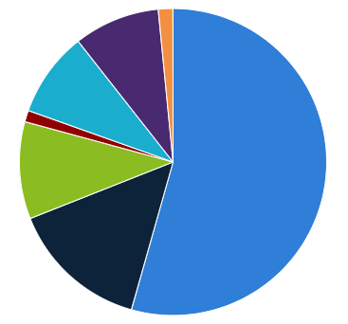
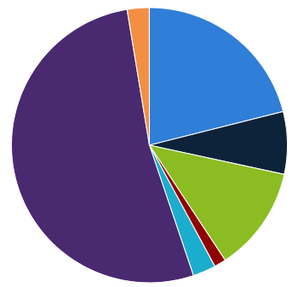
2018
Monitored workers
Collective dose

Slide 7
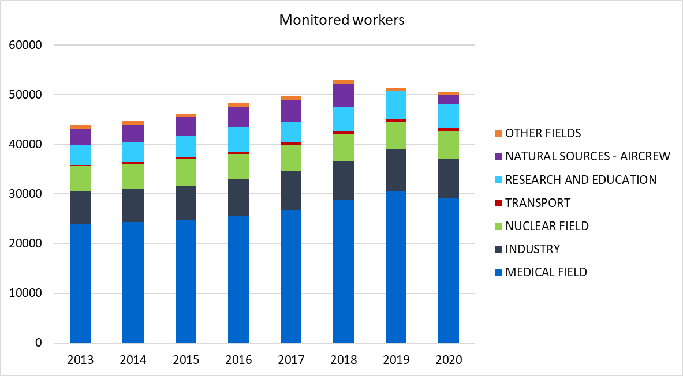
Distribution of the monitored workers in Belgium

Slide 8
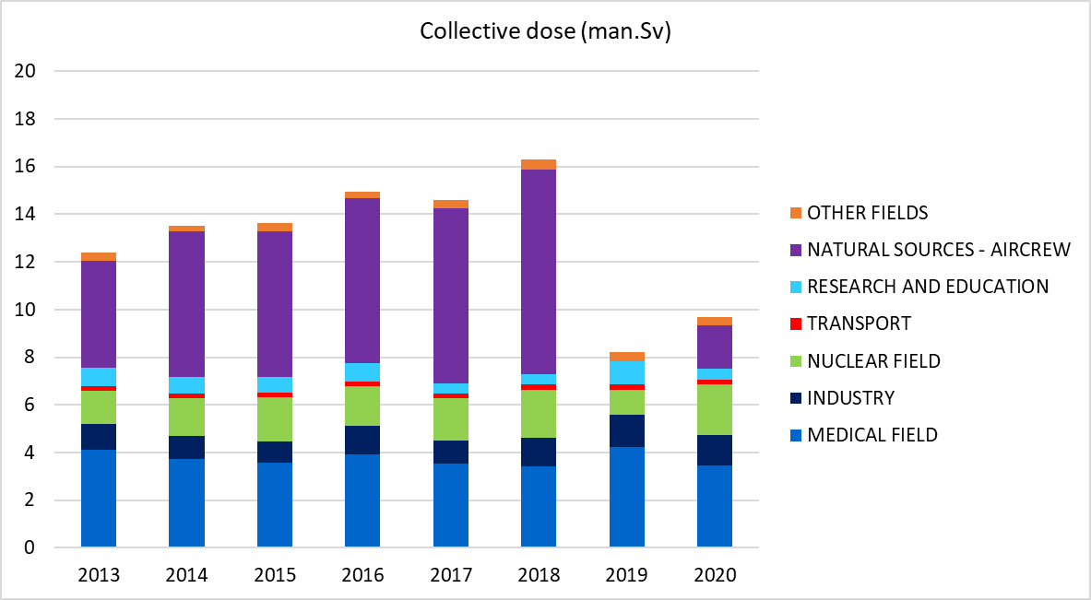
Distribution of collective dose in Belgium
The collective dose corresponds to the sum of all doses for all workers from all fields

Slide 9
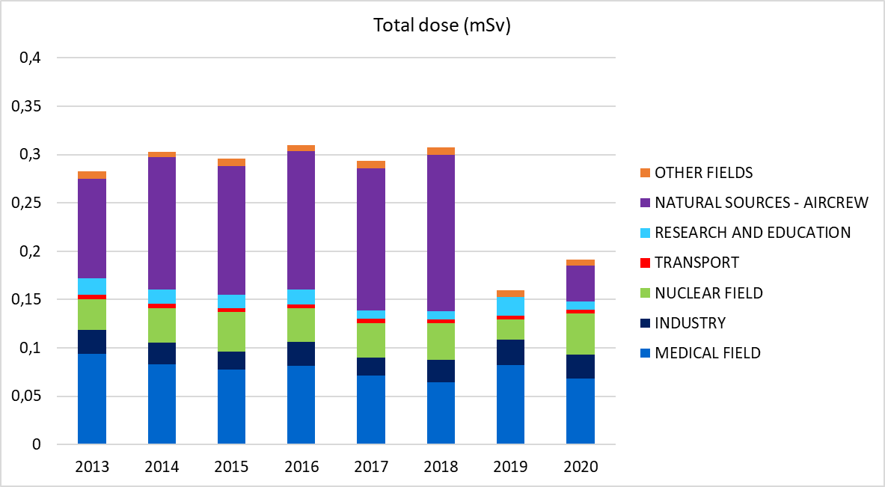
Distribution of total dose in Belgium

Slide 10
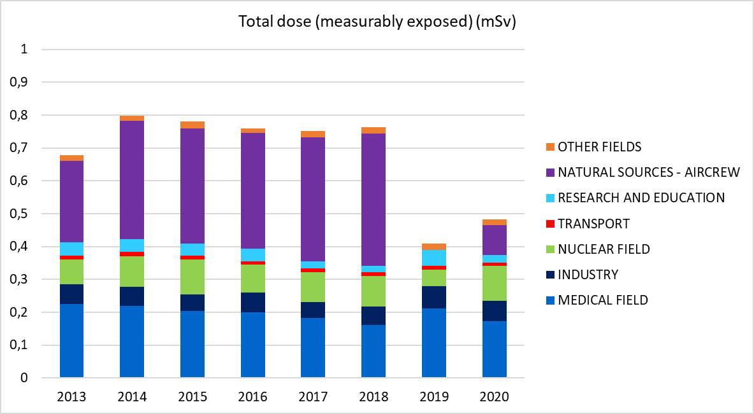
Distribution of total dose for measurably exposed in Belgium (without people who total dose = 0)

